Slide 1
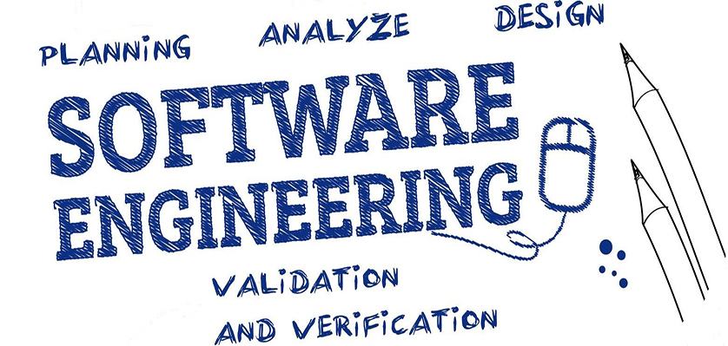
Requirements Phase
Software Engineering (SE) → CSEN 3202 – CSE/BTech/6th Semester → Module-I → Prepared by : Nilina Bera, CSE, HITK

Slide 2
Phases of a software engineering project:
requirements definition
The idea: we have a customer with needs
  well defined / nontechnical / unclear /something else ??
  A customer in the broad sense: a company, a friend, a financier or yourself?
In this phase, we try to formalize and
specify the customer needs (in order to implement a program that will eventually become a software product to be bought by customers or clients or end users)
Requirements
definition
Implementation
Maintenance
Design
Testing
Nilina Bera

Slide 3
Phases of a software engineering project:
requirements defintition
The output of requirement phase or result (should be)
  (a bunch of) specification documents containing :
    Description for customer (external, informal+formal)
    Description for the designers (internal, informal+formal)
  agreement between customer and supplier (the contract!)
    requirements functional / non-functional
    cost + (initial) schedule
    representation in good level of abstraction (not too specific, not too broad)
Requirements
definition
Implementation
Maintenance
Design
Testing
Nilina Bera

Slide 4
Requirements Engineering
Most of the software developers do not know the area of interest of the clients and the clients do not know the software development process.
As requirement engineering results in specification of almost all possible client requirements, it bridges the gap between the programmer and the client.
We can define requirement engineering as a mechanism to understand what a customer wants, analyze the software, configure the solution, and specify the validation (check of customer specification with the final deliverable ).
Verification answers the question "Are we making the product properly?" while validation - "Are we making a proper product?"

Slide 5
7 Tasks performed in Requirements Engineering (RE)
Inception : Represents the first task of RE, that includes basic case study, rough feasibility analysis, and market study.
Elicitation : Identifies the requirements of the customer. This task is done after the inception task has been performed and the project is determined. It is an important task because all the problems of a project scope are identified in this stage only.
Elaboration : This is a refining task, as the information accumulated from inception and elicitation is refined here to get accurate information and eliminate irrelevant information in the output of RE phase, i.e., SRS.
Negotiation : All the deals between the project team and the end user are done in this stage to fix the expenditure.
Nilina Bera

Slide 6
Tasks performed in Requirements Engineering
Specification : The final document developed in this stage is called the SRS document. The whole project is developed on the basis of this document.
Validation : We can think validation as a technical review of the SRS. This stage answers the following questions:
Are the requirements clearly stated?
Is the requirement source detected?
Is a requirement related to other requirements and whether this relation is clearly specified?
Is it possible to test a requirement?
Requirement management : Verifies whether the requirement phase has been performed successfully or not. This task is done by project management team.
Nilina Bera

Slide 7
Requirements Phase
Two representation levels:
  For the customer → user requirements
  For the team → system requirements
Requirements
Definition ➔ Requirement Engineering
Implementation
Testing
Maintenance
Design
Nilina Bera

Slide 8
requirements definition: user requirements
User requirement guidelines (some examples):
Use standard format / template
Use consistent language, classify requirements (!) (mandatory [’system shall…’], desirable [’system should’] etc.)
(- Highlight the keyparts of the text -)
Avoid computer jargon!
In addition to text, use diagrams & pictures
Nilina Bera

Slide 9
requirements definition: system requirements
System requirements (examples):
  Describe external behaviour of the system, not it’s design or implementation (if possible)
    In some cases, selected architecture affect on requirements → design is included to requirements
  Extend the use cases
Nilina Bera

Slide 10
Distinction in types of requirements:
functional requirements
  Services that system should provide
  How the system should react particular inputs (example: password should be alphanumeric → what happens if user enters only digits... → system must catch wrong input and show the pswd creation rules user should follow....)
  How the system should behave in particular situations (proper transaction initiated by user should complete successfully...no hiccups are accepted during the process)
non-functional (n-f) requirements
reliability, privacy, safety, efficiency, portability, usability
→ n-f requirements may affect also to the process, not only to the product (e.g. process quality(?) for safety)

Slide 11
requirements definition
Examples of non-functional requirements :
`the user interface should be implemented as simple HTML without frames or Java applet’ (product requirement)
`the system development process and documents shall conform to the process and deliverables defined in XYZ…’ (organizational requirement)
`The system shall not disclose any personal information…’ (external requirement)
Nilina Bera

Slide 12
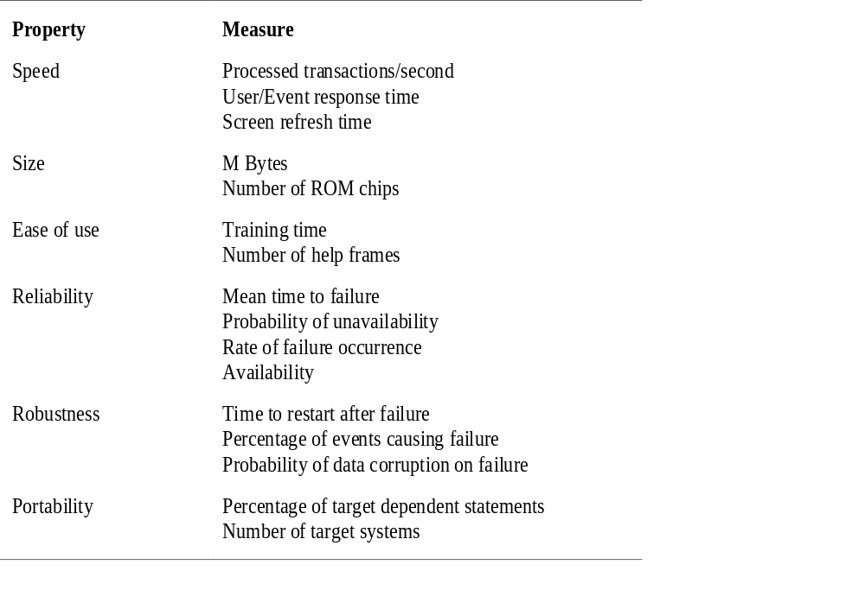
requirements definition
Metrics for non-functional
requirements
Nilina Bera

Slide 13
Representing user interaction in high level
Forms of representation: Natural language (NL), structured templates (ST), diagrams (D)
In requirements analysis:
  Scenario descriptions
  Use cases
  Sequence diagrams
Nilina Bera

Slide 14
Capturing Requirements with Use Cases
: 2. use cases
  How are use cases used to specify requirements?
  What are the benefits of using use cases to capture system requirements?
  What is the proper form of a use case?
  (What makes a use case effective/ineffective?)
Nilina Bera

Slide 15
Use Cases:
A use case is a narrative description of a goal-oriented interaction between the system under development and an external agent.
A use case captures the dialog between user and system in the form of user actions and system responses.
The Value of Use-Case Modelling
Systematic
Intuitive
Readable and understandable to the end user but also useful to developers
Can be used to drive the development process. Iterations are often defined around use cases. Use cases are a useful measure of scope or features. "That system will require about 10 use cases." gives some idea of the size of the system.
Nilina Bera

Slide 16

Use Cases: Get a good working list of your use case actors
What is an actor?
Any "object" or person that has behavior associated with it. Generally, the users are actors but often systems can be actors as well.
CASE STUDY: Use Cases of Amazon Services
There are possibly over a dozen actors that interact with Amazon services, from buyers and sellers, down to suppliers, wholesalers, auditors, and customer service.
But we're going for grass-roots, so who are the basic users of Amazon Services? BUYERS and SELLERS. So lets put them down as our first actors.
Nilina Bera

Slide 17
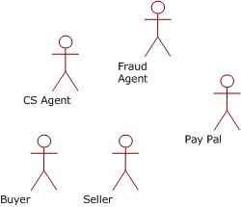

Use Cases: Get a good working list of your use case actors
Do you notice how the actors aren't Vikrant and Amarendra which would be people? While Vikrant may be a seller and Amarendra may be a buyer, an actor is a Role. And a role in this case would be that of a buyer and that of a seller.
CS Agent: Customer Service Agent
Now we have a bunch of actors. Wait a minute? Paypal? That's not a person. An actor can be a system, because a system plays another role in the context of your new system and has goals and interacts with other actors
Nilina Bera

Slide 18
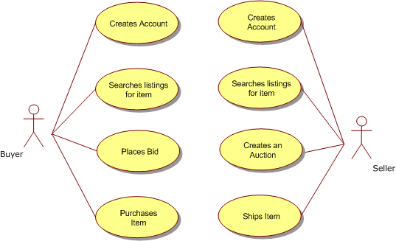
Use Cases: Define your Use Cases
Nilina Bera

Slide 19
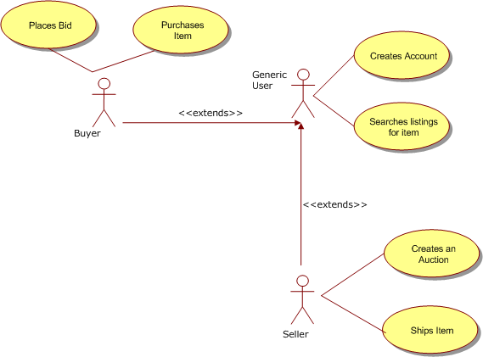
Use Cases: generalization, inheritance and extends
Generalization is when you "inherit" from something general and then add more detail. A "person" is very general. A “student" is still general, but not as general as a "person". You can say that a “student" inherits behavior and attributes of a "person".
Generic User Provides Feedback
Nilina Bera

Slide 20

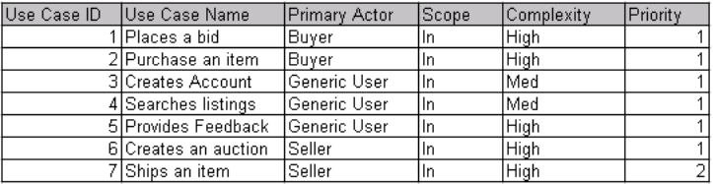
Use Cases: generalization, inheritance and extends
The above use case example diagram illustrates that a generic user creates accounts and search listings and that a buyer and a seller have their own behavior but also have the behavior of the generic user.
The benefits of generalization are that you eliminate duplicate behavior and attributes that will ultimately make the system more understandable and flexible.
Create a use case index
Nilina Bera

Slide 21
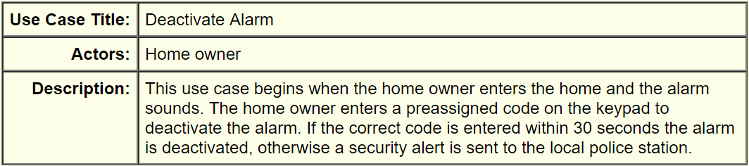
Writing Use Cases
Use cases are narrative descriptions of goal oriented interactions between the system under development and external agents.
Nilina Bera

Slide 22
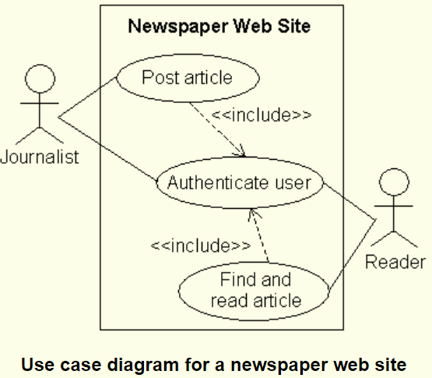
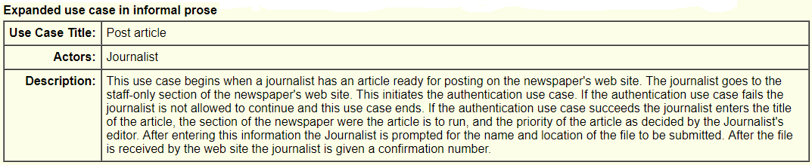
Writing Use Cases
Nilina Bera

Slide 23
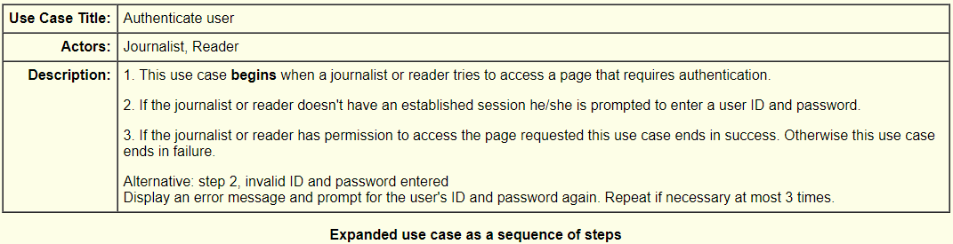
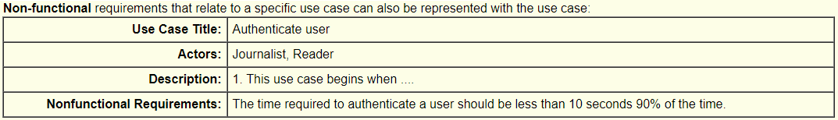
Writing Use Cases
Nilina Bera

Slide 24
Relationships Between Use Cases
A use case diagram may also show relationships between use cases. The UML defines three types of relationships:
1. Includes
2. Generalization
3. Extends
The newspaper use case diagram shown above gives an example of the includes relationship between use cases.
The Authenticate user use case is included by the other two use cases: Post article and Find and read article.
Informally, journalists as well as readers may need to enter an ID and password to get access to certain pages.
In general if use case A includes use case B this implies that at some point in A the entire contents of B should be inserted.
Nilina Bera

Slide 25
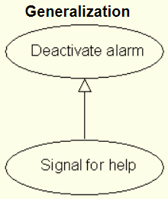
Relationships Between Use Cases
The generalization relationship is an alternative to writing a complex variation to the main scenario.
For example, consider a home security system that has a special hostage code you can type in.
(Never mind the possibility of actually remembering the hostage code while being threatened.)
If the home owner enters the special hostage code the alarm is silenced but a security alert is sent to the local police anyway.
distress signal to the local police
The Signal for help use case is a specialize form of the Deactivate alarm use case. (Think of it as a form of polymorphism.)
The Signal for help use case contains all the activity in the Deactivate alarm use case plus more. The Signal form help use case not only deactivates the alarm it also sends a distress signal to the local police.
Nilina Bera

Slide 26
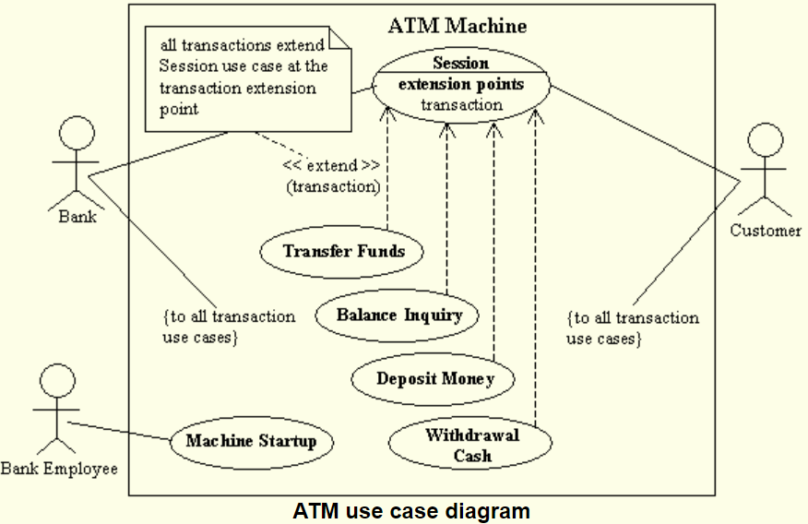
Relationships Between Use Cases
The extends relationship is like the generalization relationship with added constrains.
With the extends relationship the use case being extended is required to specify the points that can be extended.
Nilina Bera

Slide 27
Relationships Between Use Cases
Transactions are written as separate use cases that extend the base use case Session.
Use cases which extend Session are required to implement transactions.
One difference between includes and extends is that an "included" use case is essential to the completion of the use case doing the including.
A use case that extends another use case may or may not be included in the realization of the extended use case.
Nilina Bera

Slide 28
Representing user interaction in high level:
3. scenario diagrams
Scenario diagrams extend use cases
  to describe also the inner behavior of the system
  Interaction between components
  Timely dependent description
In addition, sequence diagrams are also used
to describe design and implementation of the system
→ how components interacts with each other
Nilina Bera

Slide 29
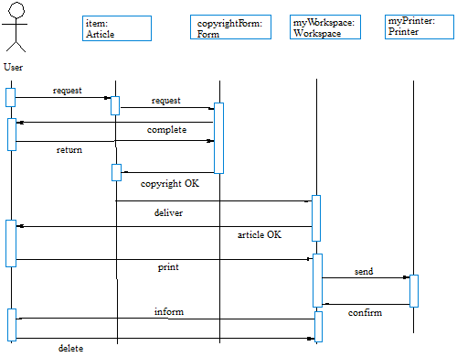
Representing user interaction in high level: 3. scenario diagrams
Nilina Bera

Slide 30
Representing user interaction in high level: 3. scenario diagrams
Scenario diagram is also known by name sequence diagram
  in general, sequence diagrams indicate interaction between objects or functional units to fulfill a certain (”bigger”) task.
  Timely dependence: sequence diagram states explicitly the order of the interaction
    But not (usually) the processing time of a component
    Relative processing time can be described by the vertical length of the activity
Nilina Bera

Slide 31
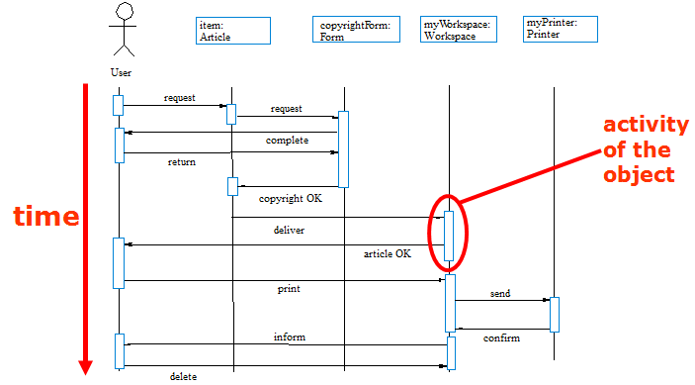
Representing user interaction in high level: 3. scenario diagrams
Nilina Bera

Slide 32
Requirements Phase
The output of this requirements phase is software requirements document (SRS)
  IEEE standard IEEE/ANSI 830-1998
Should state WHAT the system should do, not HOW it does it (how the system should operate is the responsibility of → design document)
Nilina Bera

Slide 33
Software requirements document
Document structure, essential parts bolded:
  Preface
  Introduction
  Glossary
  User requirements definition
  System architecture
  System requirements specification
  System models
  System evolution
  Appendices
  Index
Nilina Bera

Slide 34
Document structure:
  1) Preface
  -expected readership
  -version history (of this document)
  -what is new in this version
  -summary of changes
  2) Introduction
  -need for the system (=why?)
  -short description of functions
  -business / strategic objectives of the customer
  3) Glossary
  -technical terms explained
  4) User requirements definition
  -user requirements
  -non-functional system requirements
  -natural language, diagrams, controlled language, templates…
Nilina Bera

Slide 35
Software requirements document
Document structure:
  5) System architecture
  -high-level overview of the system
  -main modules and their functions represented
  6) System requirements specification
  -functional requirements in detail
  -non-functional requirements in detail
  7) System models
  -relations between system modules
  -object models? Flow models?
  8) System evolution
  -explicit notion how the system will adapt for
  changing user needs
  hardware evolution
Nilina Bera

Slide 36
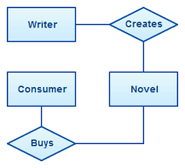
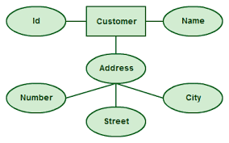
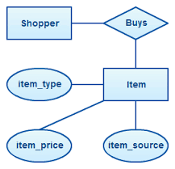
Creation of Data Model using ER Diagram
Nilina Bera

Slide 37
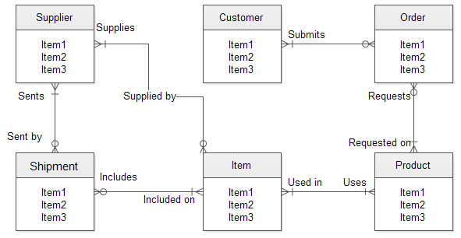
Creation of Data Model using ER Diagram
Nilina Bera

